Slide 1


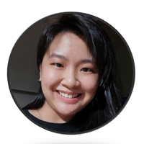




Speaker
Sabrina Kay
Explore the Integration of Conditional App Control
Sabrina Kay
oh_is_sabrina
September 16th & 17th
^{Online Event}
Powered By
International Conference

